Slide 1
Antigenic Drift and Antigenic Shift In Influenza Virus

Slide 2
Influenza
family of RNA viruses
Orthomyxoviridae.
Influenzavirus A
infects humans, other mammals, and birds, and causes all flu pandemics
Influenzavirus B
infects humans and seals
Influenzavirus C
infects humans, pigs, and dogs.
Influenzavirus D
infects pigs and cattle

Slide 3
The type A viruses are the most virulent human pathogens among the three influenza types and cause the most severe disease.
Influenza A viruses are further classified, based on the viral surface proteins hemagglutinin (HA or H) and neuraminidase (NA or N).
Sixteen H subtypes (or serotypes) and nine N subtypes of influenza A virus have been identified.

Slide 4
The serotypes that have been confirmed in humans, ordered by the number of known human pandemic deaths, are:
H1N1 caused "Spanish flu" in 1918, "Swine flu" in 2009.
H2N2 caused "Asian Flu".
H3N2 caused "Hong Kong Flu".
H5N1 is a pandemic threat.
H7N7 has unusual zoonotic potential.
H1N2 is endemic in humans and pigs

Slide 5
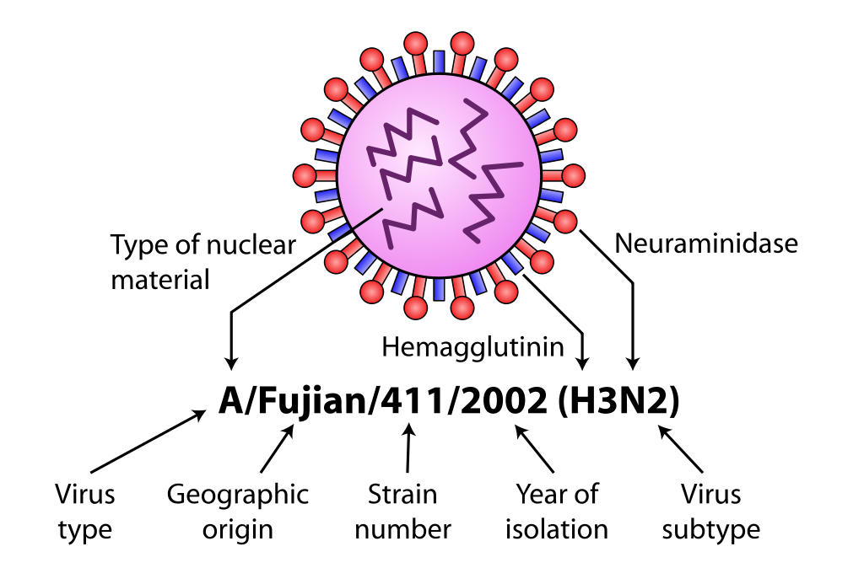
NOMENCLATURE

Slide 6
Antigenic drift is a mechanism for variation in viruses that involves the accumulation of mutations within the genes that code for antibody-binding sites.
This result in new strain of virus particles which cannot be inhibited as effectively by the antibodies that were originally targeted against previous strains, making it easier for virus to spread throughout a partially immune population.

Slide 7
Surface antigens of influenza:
Two types
Hemagglutinin
Neuraminidase
They are glycoproteins present on viral capsid.

Slide 8
Occurs with influenza A,B and C
Small number of slowly occurring changes(mutations).
Error prone viral RNA polymerase
Same subtype
HA changes most prominent, but can occur in any viral gene
Partially responsible for yearly vaccine changes
May result in epidemic

Slide 9
Mechanism
Sites recognized on hemagglutinin and neuraminidase proteins by host immune system are under constant selective pressure.
So influenza as well as other viruses have these surface protein molecules.
Among them hemagglutinin is very important to interact with host cell and start infection.
So influenza virus changes the type of hemagglutinin present on their surface and produce different sub strains of the virus.

Slide 10
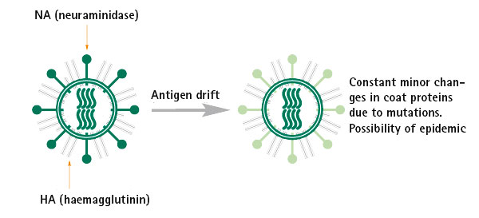

Slide 11
Not change in complete strain but still it may change the hemagglutinin spikes on the surface.
Influenza capsid is fill with hemagglutinin and neuraminidase spikes.
Small mutation in hemagglutinin may change the hemagglutinin spikes.
This make the protein unrecognizable to pre-existing host immunity.
So antibodies will no longer be functional as a result this virus can bind with host receptor and causing infection.

Slide 12
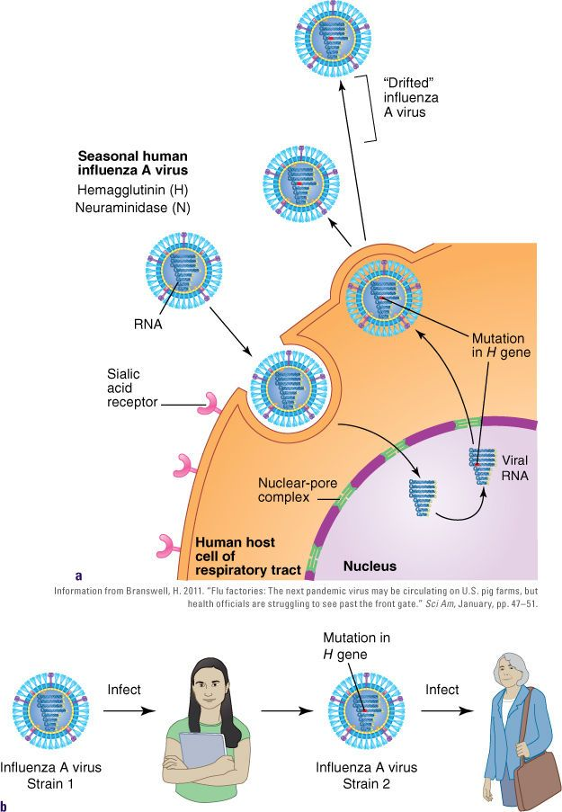

Slide 13
Antigenic shift
The process by which two or more different strains of a virus, or strain of two or more different viruses, combine to form a new subtype having a mixture of the surface antigens of the two or more original strains.
Re-assortment occurs among influenza viruses, whose genomes consist of eight distinct segments of RNA.
These segments act like mini-chromosomes, and each time a flu virus is assembled, it requires one copy of each segment.

Slide 14
